Slide 1
Hull damage experience in CSR tankers TSCF SBM, Busan October 2016
MARITIME
Ivar Håberg
Senior Principle Surveyor, DNV GL

Slide 2
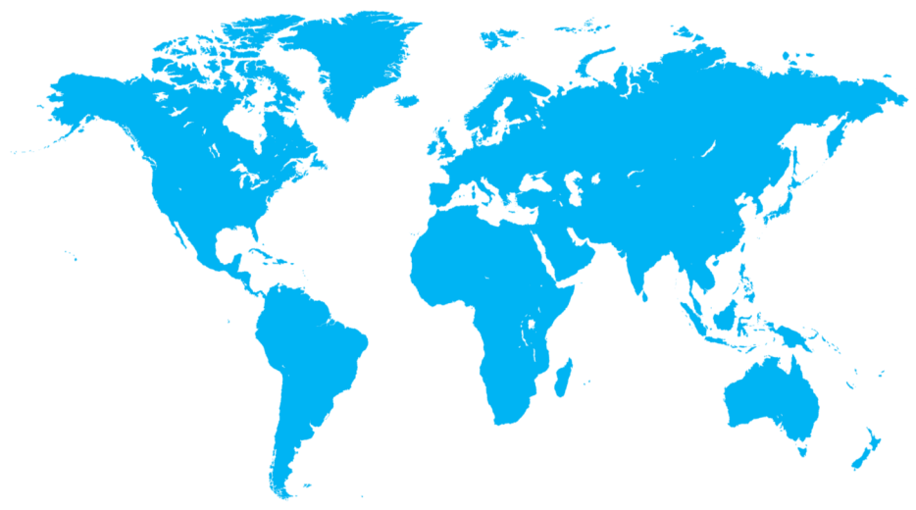
Using data to identify improvement opportunities for the industry
DNV GL NPS
World Port State
Inspections
IHS Fairplay
Ship parameters
IHS Fairplay
Ship Incidents
Annual key figures
Annual key figures
Key figures
Annual key figures
13,000 ships
26,000 periodical surveys
22,000 non conformities
90,000 findings
88,000 inspections
80,000 ships
1,700 serious incidents

Slide 3
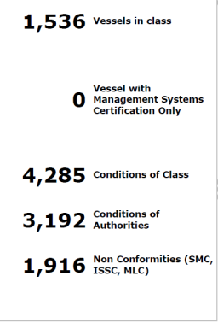
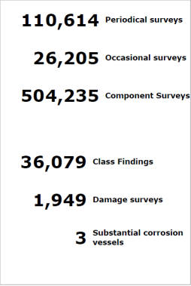
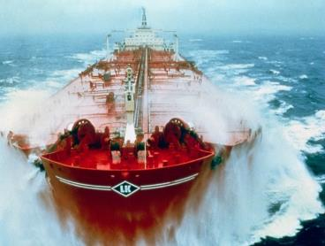
Main Class observations - Tankers 2010–2016, DNV GL fleet
Investigation of hull damages based on DNV GL classed fleet of tankers
On average 1 CC, CA, or NC per tanker / year

Slide 4
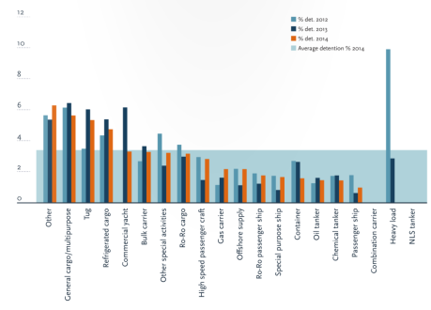
Findings frequency per ship type
Class and Statutory Findings
DNV GL Vessels
Port State Findings
WW fleet
Class findings for tanker fleet similar to PSC finding trend
Need special focus due to high environmental focus

Slide 5
Hull findings per 1000 ship years 2010-2015, DNV GL Vessels

Slide 6
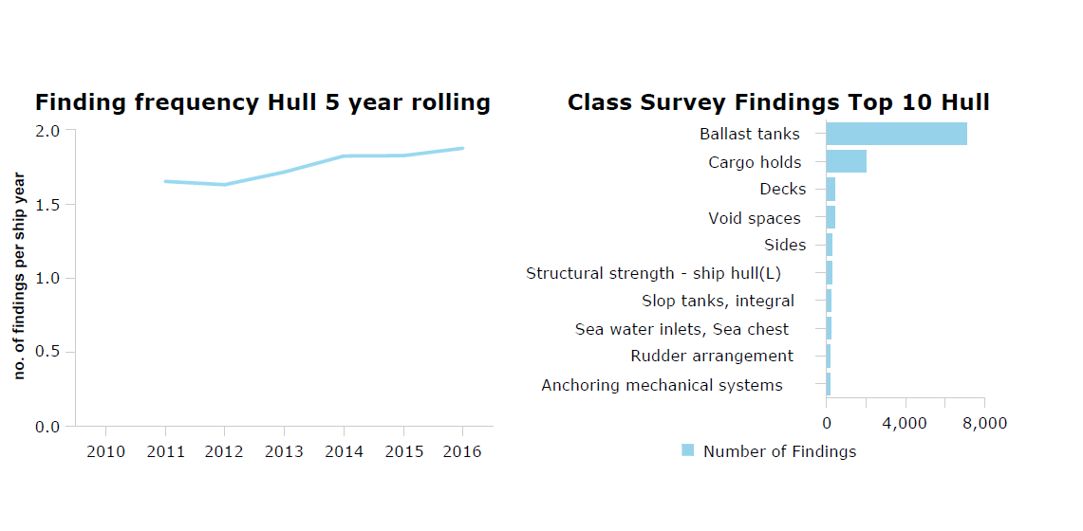
Hull findings, DNV GL Tankers
Moderate growth in hull findings, but still low
Main focus area is cargo area

Slide 7
Distribution of hull damages, DNV GL Tankers 2006-2016
50% of the hull findings are corrosion related
Cracks account for about 25%
Indents – deformation third most frequent damage cause
Finding Type | Number of Findings
Corroded | 16906
Crack | 8133
Deformation | 5249
Pitting | 1677
Equipment | 791
Buckling | 560
Leakage | 427
With CSR - did we solve the fatigue crack challenge for tankers permanently?

Slide 8
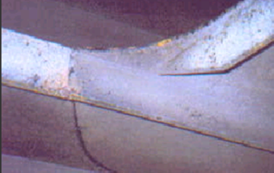
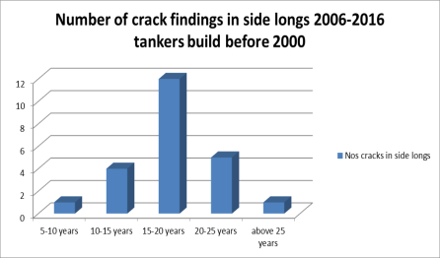
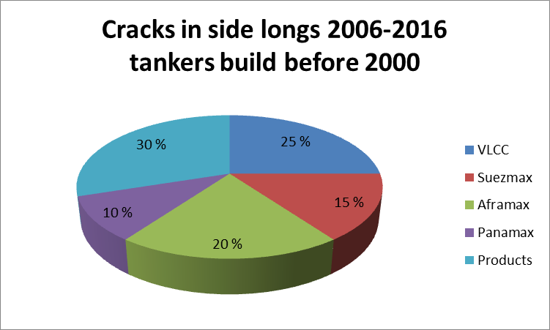
Finding analysis cracks in double side ballast tanks, side longits.
Tanker for Oil, built before 2000:
Survey reports from 2006 to 2016
Reported cracks in side longs
44 crack findings involving 23 ships
Identified cracks in side longits, 2006-2016
Tankers built before 2000
Cracks in side longits, 2006-2016
Tankers built before 2000

Slide 9
Finding analysis cracks in double side ballast tanks, side longits.
Tanker for Oil, built after year 2000
Survey reports from 2006 to 2016
Reported cracks in side longs
0 crack findings
Tankers built to DNV GL Rules after 2000 have adequate fatigue strength for the side longitudinal connections to web frames and bulkheads
CSR Rules are improving on this standard by introducing an improved design standard with 25 years design fatigue life

Slide 10
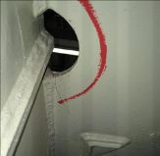
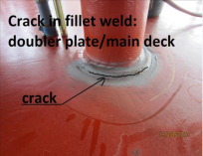
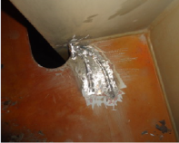
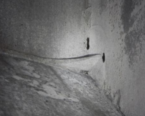
DNV GL CSR Tankers survey experience
Cracks reported from 2006-2016

Slide 11
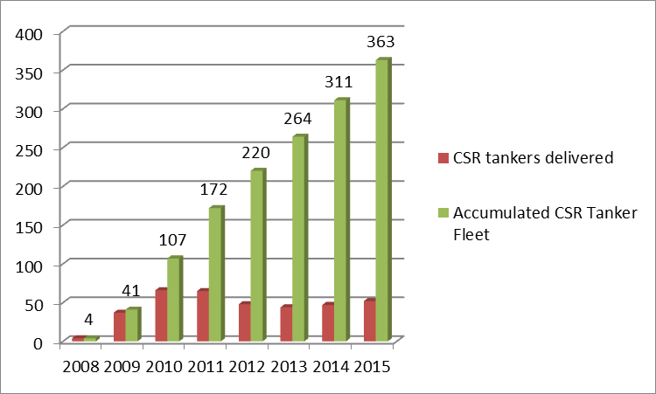
CSR Tankers included in this analysis
Period 2008-2016
363 CSR Tankers analyzed
1482 Accumulated CSR tanker years
Less than 40% passed first Renewal Survey Hull

Slide 12
Hull damages CSR vs. non-CSR Tankers, first year after delivery
0-1 year CSR
0-1 year non-CSR
Finding Type | Number of Findings
Crack | 15
Deformation | 26
Buckling | 2
Leakage | 1
Equipment | 0
Corroded | 0
Pitting | 0
Finding Type | Number of Findings
Crack | 38
Deformation | 58
Buckling | 7
Leakage | 8
Equipment | 1
Corroded | 1
Pitting | 0

Slide 13
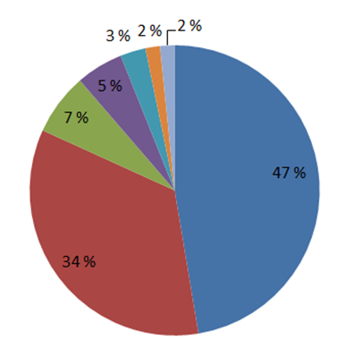
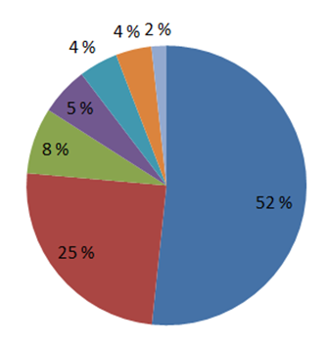
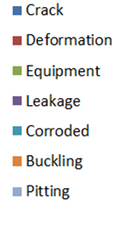
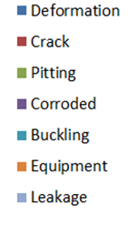
Hull damages CSR vs. non-CSR Tankers, 1-5 years
1-5 year CSR
1-5 year non-CSR
v
v
Finding Type | Number of Findings
Crack | 117
Deformation | 85
Buckling | 4
Leakage | 13
Equipment | 17
Corroded | 7
Pitting | 4
Finding Type | Number of Findings
Crack | 456
Deformation | 953
Buckling | 83
Leakage | 32
Equipment | 76
Corroded | 103
Pitting | 141

Slide 14
Hull damages CSR vs. non-CSR Tankers, 5-10 years
5-10 year CSR
5-10 year non-CSR
Finding Type | Number of Findings
Crack | 3
Deformation | 19
Buckling | 2
Leakage | 0
Equipment | 0
Corroded | 3
Pitting | 0
Finding Type | Number of Findings
Crack | 965
Deformation | 1092
Buckling | 120
Leakage | 69
Equipment | 144
Corroded | 1091
Pitting | 288

Slide 15
Crack frequency per ship year, CSR vs. non-CSR Tankers
CSR Tankers: Expected to be significantly reduced due to improved fatigue standard
CSR
non-CSR
Production related
Design related

Slide 16
CSR tankers – do they crack? - already ?
Design standard 25 years North Atlantic trade
The first CSR tankers are now 8 years old
A total of 135 cracks are found
Why?
Production related cracks
Vibration related cracks (not CSR scope)
Design related cracks (not CSR scope)
Cracks covered by CSR scope and approved according to the CSR standard

Slide 17
Distribution of cracks in CSR Tankers sorted by structural elements

Slide 18
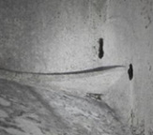
Cracks in CSR Tankers due to design and production
Cracks at equipment fitted to deck and bulkheads:
Welding with fillet weld in large pipe penetrations
Relative deflection between deck equipment and deck hull structure
Openings made too close to each other
Hull structural cracks due to:
Poor weld performance in critical connections
Intersecting elements creating hard points
Stringer toe heel bracket too stiff
Lack of support in knuckles in fwd/aft cargo tanks
Notes:
54 Design related cracks, 43 cracks related to equipment, two series represent 80% of these cracks

Slide 19
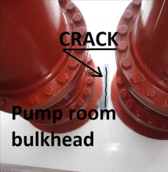
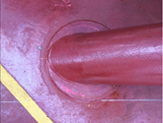
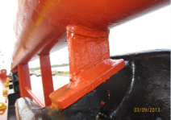
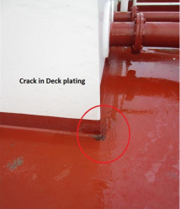
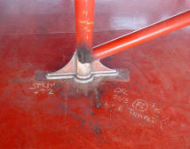
Examples of cracks, Equipment and deck fittings
Examples of cracks on deck in way of equipment
Deck house corner missing bracket
Cargo pipe penetrations too close
Doubler plate too small
Hose handling crane welded to panama chock
Pipe sleeves welded with fillet weld

Slide 20
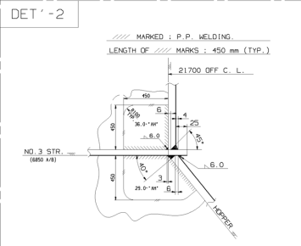
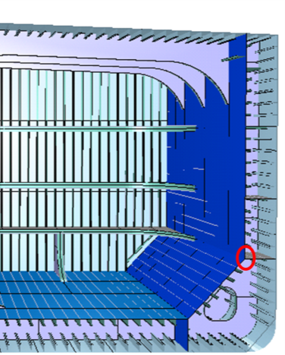
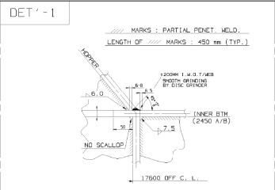
Examples of production related cracks in weld connections
7 Cracks above lower stringer –
“crack on welding seam between longitudinal bulkhead and below lower stringer”
13 Cracks below lower stringer:
“Crack on welding seam between longitudinal bulkhead and below lower stringer”
2 Cracks in way of lower knuckle detail 1
“Crack on the lower knuckle of hopper plating”

Slide 21
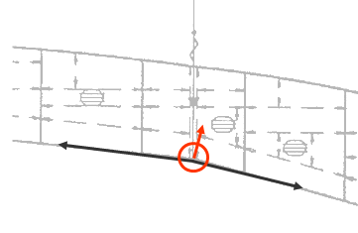
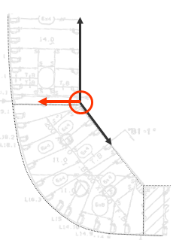
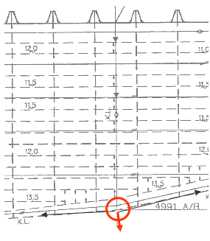
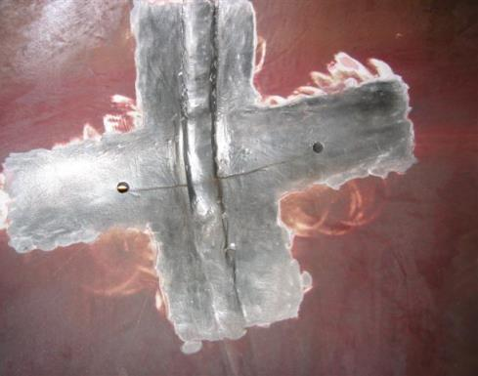
Design related crack in way of 3D knuckle (e.g. aft cargo hold)
Transverse web frame
Longitudinal bulkhead
Side stringer
Knuckles in three directions in one location
Knuckle 100 mm from web frame

Slide 22
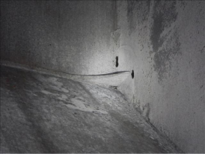
Example of design/welding related crack
4 year old vessel
Crack in transverse bulkhead plating iwo. toe of integral bracket in extension of side stringer plate inside cargo tank
Welding defects in weld of existing insert on bulkhead plating and on welding between transverse bulkhead, longitudinal bulkhead and extension of side stringer plate inside cargo tank
Defective welding was gauged out and re-welded with full penetration welding
Cracked bulkhead plate was cropped and renewed by insert
CSR required bracket size:
800X600 R 550

Slide 23
Crack experience for CSR Oil Tankers, main observations:
Crack frequency for CSR Tankers slightly below that of non-CSR Tankers
Damage statistics indicate that CSR is an improved design standard
Cracks due to production issues (welding defects) is the main contributor.
One series with numerous welding defect cracks in the hopper knuckle area represent 50% of the production related cracks
Consequence of cracks in these location is breach of the cargo tank boundary and minor leakages to the ballast tank
Design related cracks are mainly related to deck equipment details not part of CSR scope. These damages are dominated by one series of ships operating in especially fatigue exposed environment
Cracks due to hull vibrations represent 15% of the cracks. This is not CSR scope
It’s too early to conclude on the impact of the improved fatigue standards built into the CSR Rules, but damage statistics show a positive trend
Notes:
Crack frequency for CSR Tankers slightly below that of non-CSR Tankers
CSR is an improved design standard. Cracks due to workmanship is another issue where quality in the production line is the key factor
Cracks due to production issues (welding defects) is the main contributor.
One series with numerous welding defect cracks in the hopper knuckle area represent 50% of the production related cracks
Consequence of cracks in these location is breach of the cargo tank boundary and minor leakages to the ballast tank
The design related cracks are mainly related to deck equipment details not part of CSR scope. These damages are dominated by one series of ships operating in especially fatigue exposed environment
Cracks due to hull vibrations represent 15% of the cracks. This is not CSR nor class scope
It’s too early to observe the impact of the improved fatigue standards built into the CSR Rules

Slide 24
Ivar.haaberg@dnvgl.com
+47 95 04 21 49

